Slide 1
Gatling Update
Björn Beskow
2016-10-11

Slide 2
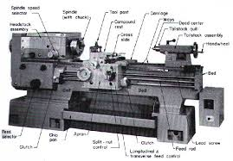

Load testing tools
Historically, Load Testing tools have been complex and expensive
LoadRunner
Rational Performance Tester
…
Lately, they have been challenged by open source alternatives
Apache JMeter
LoadUI
Grinder
…

Slide 3
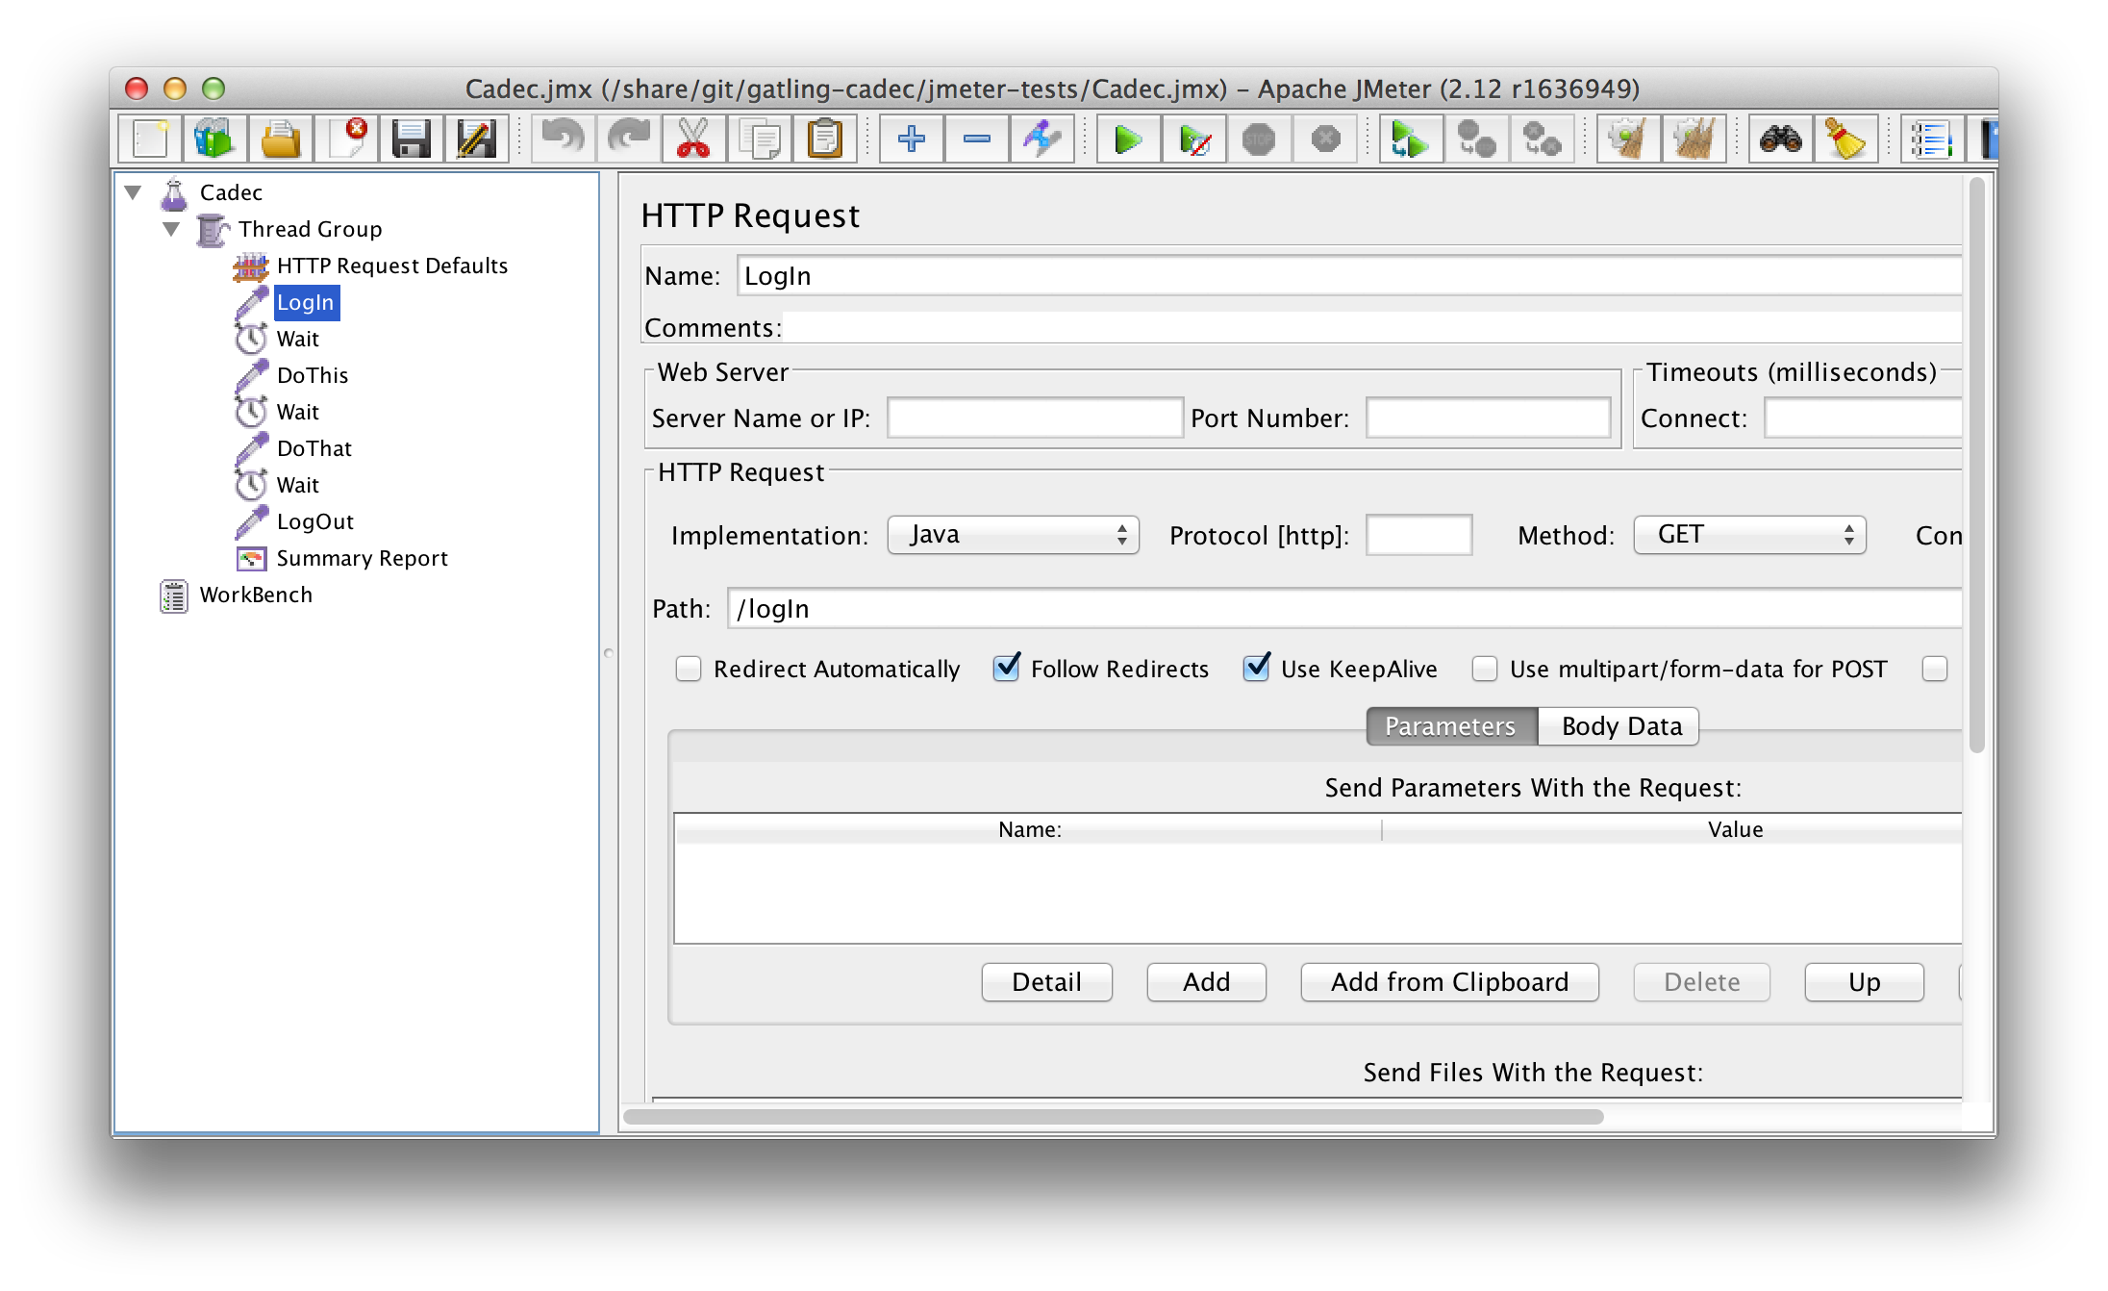
Jmeter with friends: Issue #1 Graphical User Interface

Slide 4

Jmeter with friends: Issue #1
Severely affects maintainability

Slide 5

Jmeter with friends: Issue #1
Clumsy integration with build automation and Continuous Integration tools

Slide 6

Jmeter with friends: Issue #2 Performance
Blocking I/O
means
1 user = 1 thread

Slide 7

Jmeter woe: Threads

Slide 8
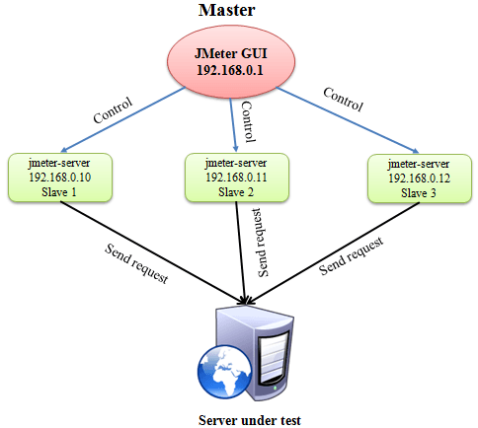
Jmeter with friends: Issue #2 solved?

Slide 9

Gatling.io
Released in October 2012
Now in version 2.2.2
Different in 2 significant ways
Domain Specific Language (DSL) for expressing scenarios, instead of GUI
Uses modern, non-blocking technology (Scala, Akka, Netty), which means generating sufficient load on a single machine suddenly becomes feasible

Slide 10

Gatling to the rescue!

Slide 11
Verifying non-functional aspects …
Business Facing
Manual
Automated & Manual
Functional Tests
Story Tests
Exploratory Tests
UAT
Support Development
Critique Product
Unit Tests
Component Tests
Performance Tests
Security Tests
"…ility" Tests
Tools
Automated
Technology Facing
Source & Copyright: Brian Marick 2007

Slide 12
… should be done proactively as well!
Business Facing
Manual
Automated & Manual
Functional Tests
Story Tests
Exploratory Tests
UAT
Support Development
Critique Product
Unit Tests
Component Tests
Performance Tests
Performance Tests
Security Tests
"…ility" Tests
Tools
Automated
Technology Facing
Source & Copyright: Brian Marick 2007

Slide 13
Gatling Scenario
Represents a User Scenario, i.e. a sequence of actions a user performs in a certain situation
Defined using control structures
Base structures
Loops
Conditions

Slide 14
Gatling Simulation
A number of scenarios performed by a number of users, which together generate desired load
Users may be injected, or
Throttling may be defined, to reach a specific load

Slide 15
Gatling Feeder
Provides test data to scenarios
Different feeder types
csv
jdbc
redis
…
Different feeder strategies
queue
random
circular
…

Slide 16
Gatling Assertions
Assertions on responses, to guarantee correct functional behavior despite load

Slide 17
Gatling Protocols
http/https
Server Sent Events
WebSockets
JMS

Slide 18
Gatling getting started
Download zip bundle, or download via maven
<dependency>
<groupId>io.gatling.highcharts</groupId>
<artifactId>gatling-charts-highcharts</artifactId>
<version>2.2.2</version>
</dependency>
or via gradle
dependencies {
compile 'io.gatling.highcharts:gatling-charts-highcharts:2.2.2'
compile 'org.scala-lang:scala-compiler:2.9'
compile 'org.scala-lang:scala-library:2.9'
}

Slide 19
Gatling getting started
or via sbt
libraryDependencies += "io.gatling.highcharts" % "gatling-charts-highcharts" % "2.2.2"

Slide 20
Maven project archetype
mvn archetype:generate
When prompted to provide a filter, type
gatling
then choose
1: remote -> io.gatling.highcharts:gatling-highcharts-maven-archetype

Slide 21
Step 1
Clone git repo from https://github.com/callistaenterprise/gatling-update.git
Start system-under-test:
system-under-test> mvn spring-boot:run

Slide 22
Run Recorder
mvn exec:java -Dexec.mainClass=Recorder \
-Dexec.classpathScope=test \
-Djava.awt.headless=false
Then set proxy to localhost:8000 in a browser, start the recorder, then direct the browser to localhost:9090/logIn, localhost:9090/doThis, localhost:9090/doThat, localhost:9090/logOut

Slide 23
Run the recorded simulation
gatling-tests> mvn gatling:execute

Slide 24
Additional steps
Step 2: Clean up recording.
Step 3: Add loop.
Step 4: Add feeder.
Step 5: Refactor into smaller pieces.
Step 6: Add Assertion.
Step 7: Add rampUp to simulation.

